Slide 1
Solution Sets for Equations and Inequalities
Algebra I- Unit-Equations
Mr. Sierocinski

Slide 2
Student Outcomes-Objectives

Slide 3

Classwork-Whole Class
Consider the equation, $x^{2}=3x+4$, where $x$ represents a real number.
Are the expressions x^2 and 3x+4 algebraically equivalent?
The following table shows how we might “sift” through various values
to assign to the variable symbol x in the hunt for values that would make
the equation true.
$x$-VALUE | THE EQUATION | TRUTH VALUE
Let $x=0$ | $$0^{2}=3(0)+4$$ | FALSE
Let $x=5$ | $$5^{2}=3(5)+4$$ | FALSE
Let $x=6$ | $$6^{2}=3\left(6\right)+4$$ | FALSE
Let $x=−7$ | $${(−7)}^{2}=3(−7)+4$$ | FALSE
Let $x=4$ | $$4^{2}=3(4)+4$$ | TRUE
Let $x=9$ | $$9^{2}=3(9)+4$$ | FALSE
Let $x=10$ | $$10^{2}=3(10)+4$$ | FALSE
Let $x=−8$ | $${(−8)}^{2}=3(−8)+4$$ | FALSE

Slide 4
Solution Sets-Definition
The solution set of an equation written with only one variable is the set of all values one can assign to that variable to make the equation a true statement. Any one of those values is said to be a solution to the equation.
To solve an equation means to find the solution set for that equation.

Slide 5
Displaying Solution Sets
Solve for $a$: $a^{2}=25$.
One can describe a solution set in any of the following ways:
IN WORDS: $a^{2}=25$ has solutions $5$ and $−5$. (That is, $a^{2}=25$ is true when $a=5$ or $a=−5$.)
IN SET NOTATION: The solution set of $a^{2}=25$ is $\left\{−5, 5\right\}$.
IN A GRAPHICAL REPRESENTATION ON A NUMBER LINE: The solution set of $a^{2}=25$ is
In this graphical representation, a solid dot is used to indicate a point on the number line that is to be included in the solution set. (WARNING: The dot one physically draws is larger than the point it represents. One hopes that it is clear from the context of the diagram which point each dot refers to.

Slide 6
How set notation works:
The curly brackets { } indicate we are denoting a set. A set is essentially a collection of things, e.g., letters, numbers, cars, people. In this case, the things are numbers.
From this example, the numbers −5 and 5 are called elements of the set. No other elements belong in this particular set because no other numbers make the equation 𝑎^2 = 25 true.
When elements are listed, they are listed in increasing order.
Sometimes, a set is empty; it has no elements. In which case, the set looks like { }. We often denote this with the symbol, ∅. We refer to this as the empty set or the null set.

Slide 7
Writing Solution Sets-Ex.1
Present the solution sets in words, notation and graphically for the following equations:
a^2=25
7+p=12
10w+3=33
X^3=27

Slide 8
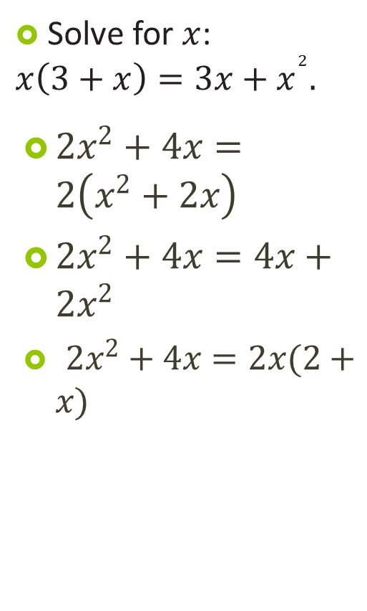
Identity Equation
Solve for $x$: $x\left(3+x\right)=3x+x^{2}.$
$2x^{2}+4x=2\left(x^{2}+2x\right)$
$2x^{2}+4x=4x+2x^{2}$
$2x^{2}+4x=2x(2+x)$
An identity is an equation that is always true.

Slide 9

Create-I do
$2x−5$ =
$x^{2}+x$ =
$4·x·y·z =$
${\left(x+2\right)}^{2}$ =
Identity Equations

Slide 10
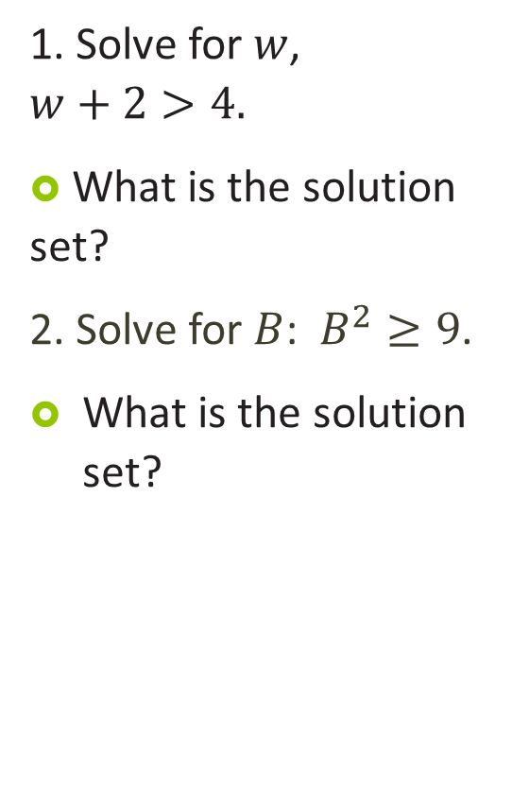
Solution Sets-Cont
1. Solve for $w$, $w+2>4.$
What is the solution set?
2. Solve for $B$: $B^{2}≥9$.
What is the solution set?
Inequalities

